Slide 1
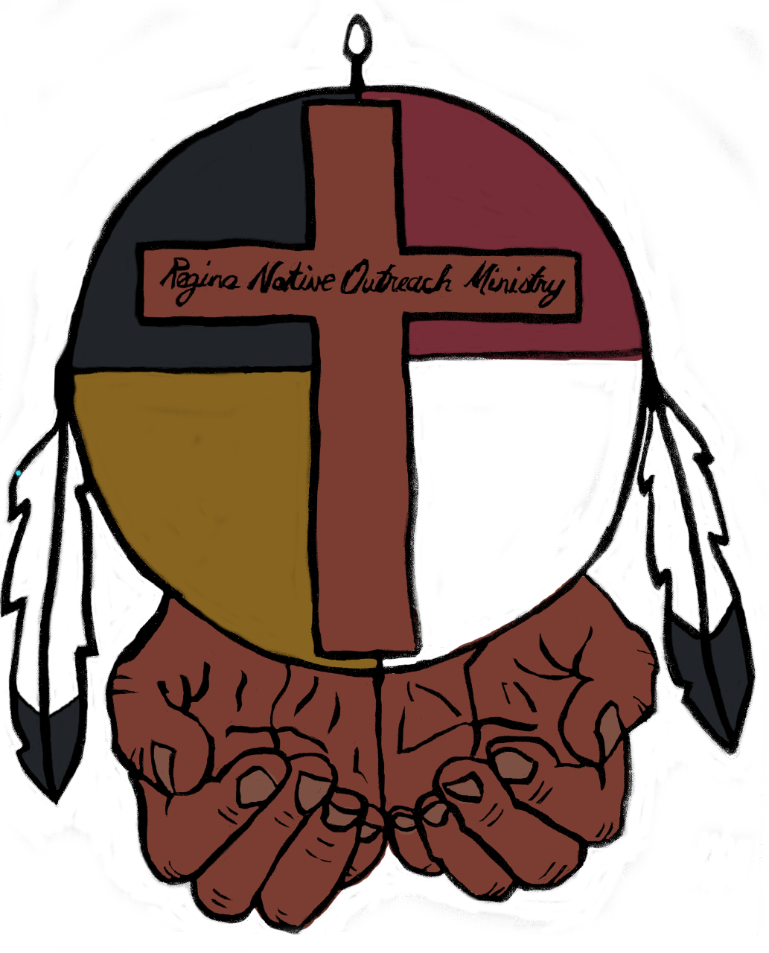
Minute for Reconciliation Red Dress Day May 5, 2026 National Day of Awareness for Missing and Murdered Indigenous Women, Girls, and 2SLGBTQQIA+ People For a copy of this Minute for Reconciliation and more information, email reginanativeoutreachministry@gmail.com

